Slide 1
Microprocessors, Microcontrollers & Embedded systems
8051 Serial communication & Peripherals

Slide 2
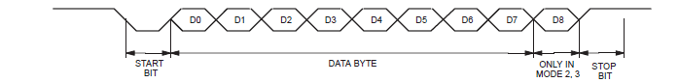
8051 Serial Communication
Registers
SBUF (0x99)
Consists of two separate buffers (transmit & receive)
When data is moved to SBUF, it is moved to transmit buffer for transmission
When data is read from SBUF, receive buffer provides the data
SCON (0x98)
Controls data communication
PCON (0x87)
Controls data rates
Serial data interrupts
TI flag in SCON is set when Tx byte is complete
RI flag in SCON is set when Rx buffer is full
Program shall check the source for interrupt & explicitly clear the flag
Serial communication byte

Slide 3
8051 Serial Communication
Data transmission
Transmission begins as soon as the data is written to SBUF
TI is set to 1 when data SBUF is empty
Data Reception
Begins reception for all modes if REN =1 in SCON
RI is set after data is received
In mode 0, RI should be cleared for new byte reception
In modes 1,2,3, RI should be cleared before last bit of new data is received. Else, new data will be lost. New data is copied to SBUF only after last bit is received. Previous byte can be read until then
Serial Data modes
Mode 0 – Shift Register mode
Mode 1 – Standard UART
Mode 2 – Multiprocessor mode
Mode 3 – Multiprocessor mode

Slide 4
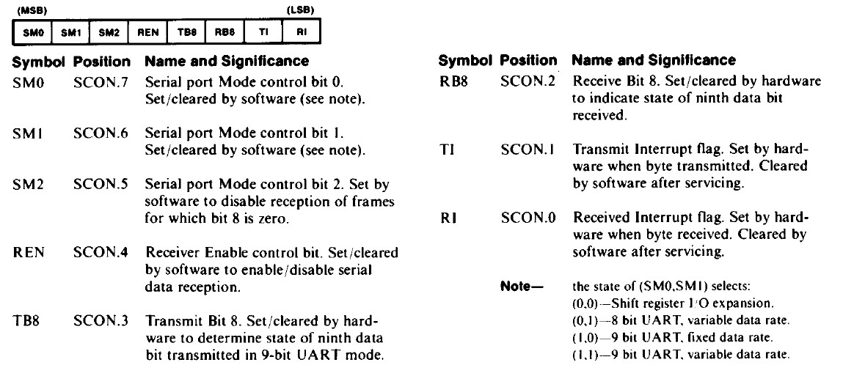
8051 Serial Communication
SCON register

Slide 5
8051 Serial Communication
PCON register
SMOD | - | - | - | GF1 | GF0 | PD | IDL
Bit number | Bit Mnemonic | Description
7 | SMOD | Serial port mode bit 1 for UART; Set to double baudrate in modes 1, 2, 3
3 | GF1 | General purpose flag
2 | GF0 | General purpose flag
1 | PD | Power-down mode bit Cleared by hardware when reset occurs Set to enter power-down mode
0 | IDL | Idle mode bit Cleared by hardware when interrupt or reset occurs Set to enter idle mode

Slide 6
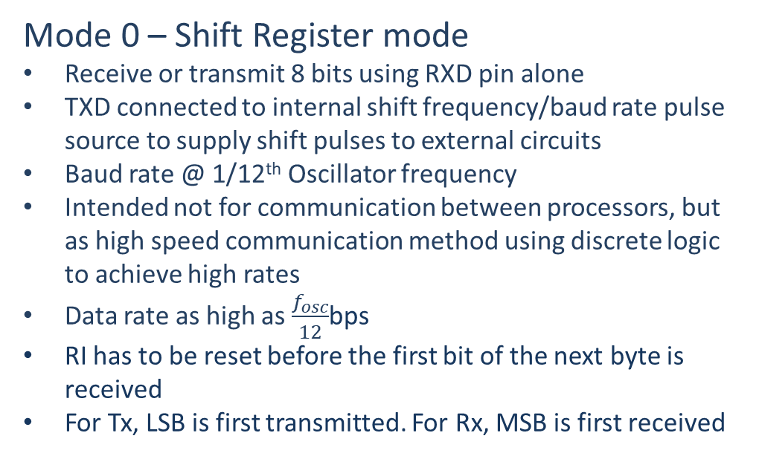
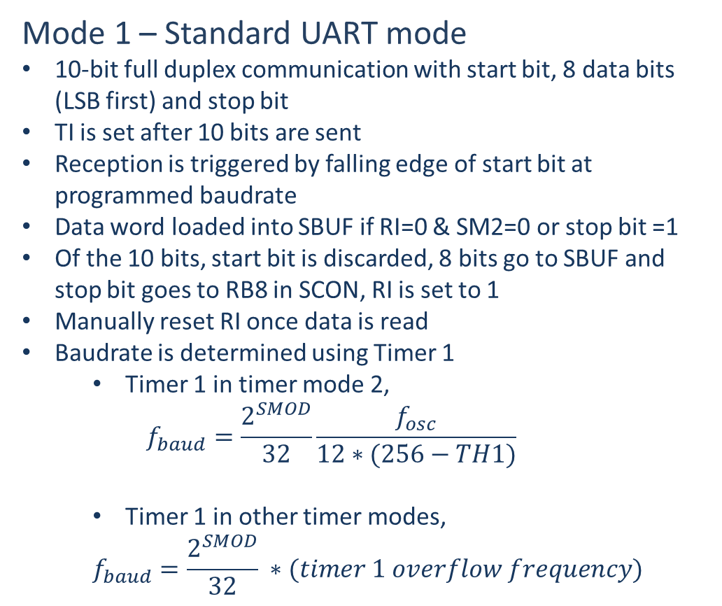
8051 Serial Communication
Mode 0 – Shift Register mode
Receive or transmit 8 bits using RXD pin alone
TXD connected to internal shift frequency/baud rate pulse source to supply shift pulses to external circuits
Baud rate @ 1/12th Oscillator frequency
Intended not for communication between processors, but as high speed communication method using discrete logic to achieve high rates
Data rate as high as $\frac{f_{osc}}{12}$bps
RI has to be reset before the first bit of the next byte is received
For Tx, LSB is first transmitted. For Rx, MSB is first received
Mode 1 – Standard UART mode
10-bit full duplex communication with start bit, 8 data bits (LSB first) and stop bit
TI is set after 10 bits are sent
Reception is triggered by falling edge of start bit at programmed baudrate
Data word loaded into SBUF if RI=0 & SM2=0 or stop bit =1
Of the 10 bits, start bit is discarded, 8 bits go to SBUF and stop bit goes to RB8 in SCON, RI is set to 1
Manually reset RI once data is read
Baudrate is determined using Timer 1
Timer 1 in timer mode 2,
$$f_{baud}=\frac{2^{SMOD}}{32}\frac{f_{osc}}{12∗(256−TH1)}$$
Timer 1 in other timer modes,
$$f_{baud}=\frac{2^{SMOD}}{32} ∗(timer 1 overflow frequency)$$
What will be the TH1 & $f_{osc}$ values to generate a baudrate of 9600 bps?
Notes:
In mode 1, SM2 set to 1 enables reception of byte with any stop-bit state.

Slide 7
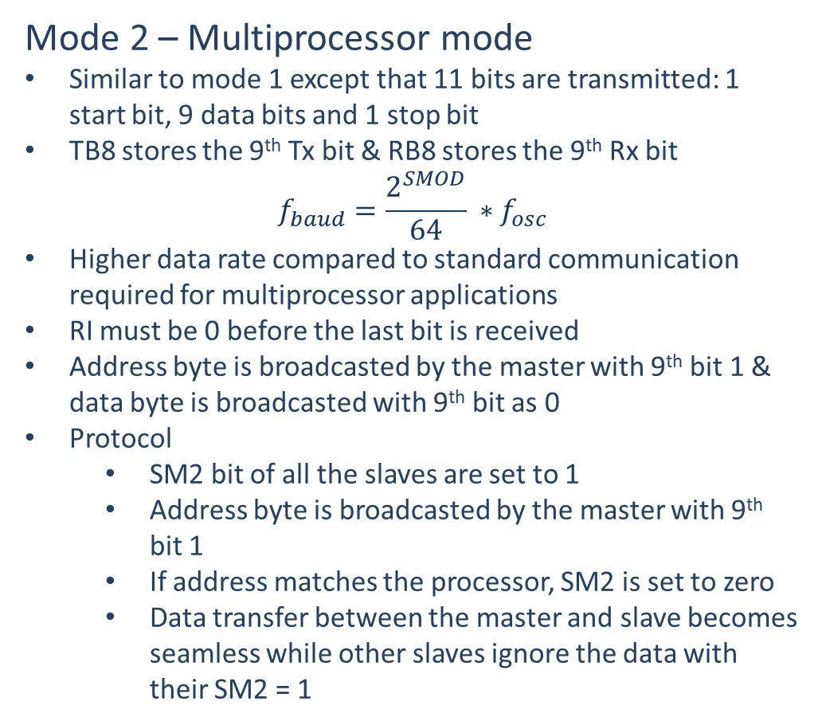
8051 Serial Communication
Mode 2 – Multiprocessor mode
Similar to mode 1 except that 11 bits are transmitted: 1 start bit, 9 data bits and 1 stop bit
TB8 stores the 9th Tx bit & RB8 stores the 9th Rx bit
$$f_{baud}=\frac{2^{SMOD}}{64} ∗f_{osc}$$
Higher data rate compared to standard communication required for multiprocessor applications
RI must be 0 before the last bit is received
Address byte is broadcasted by the master with 9th bit 1 & data byte is broadcasted with 9th bit as 0
Protocol
SM2 bit of all the slaves are set to 1
Address byte is broadcasted by the master with 9th bit 1
If address matches the processor, SM2 is set to zero
Data transfer between the master and slave becomes seamless while other slaves ignore the data with their SM2 = 1
Mode 3 – Multiprocessor mode
Identical to mode 1 except the baud rate which is determined using timer 1 similar to Mode 1
Serial communication byte
Notes:
No need to discuss too much about these modes. Move on…

Slide 8
Peripherals
Notes:
No need to discuss too much about these modes. Move on…

Slide 9
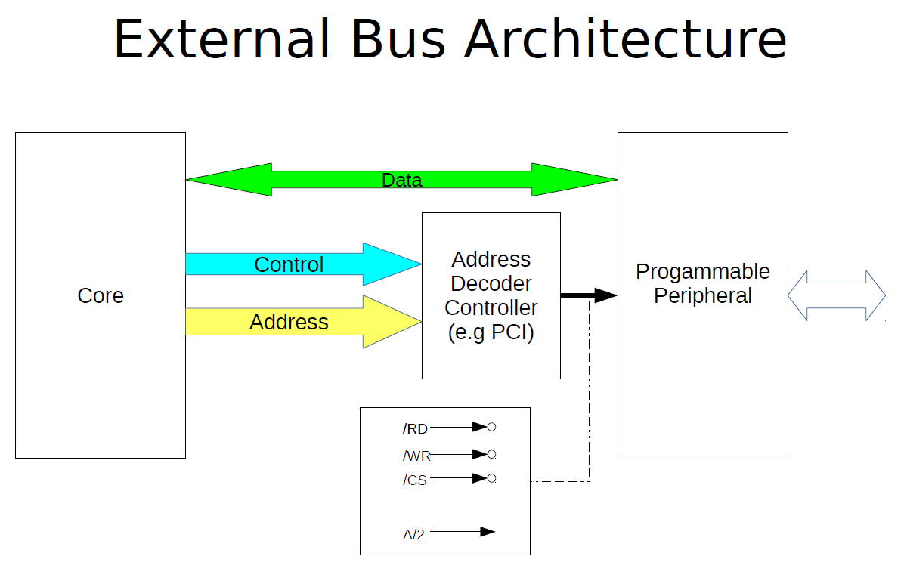
Courtesy: Prof Subramanian’s yesteryear slides
Notes:
No need to discuss too much about these modes. Move on…

Slide 10
Programmable controllers
Programmable Interval Timer :8254
Programmable Interrupt Controller: 8259A
Programmable Peripheral Controller: 8255
Programmable DMA Controller: 8257A
Programmable Keyboard/Display
Notes:
No need to discuss too much about these modes. Move on…

Slide 11
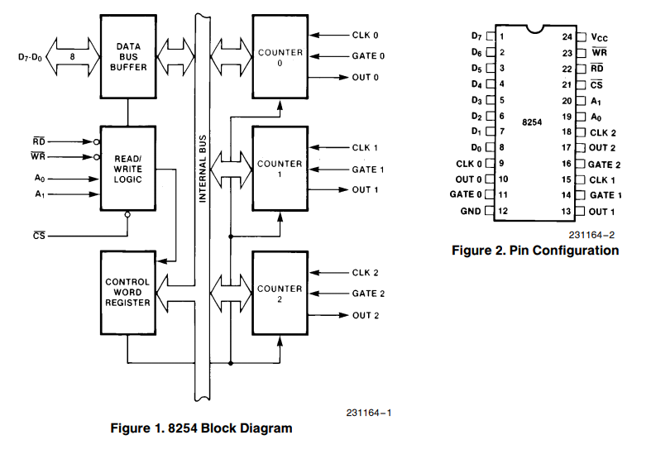
Programmable controllers
Programmable Interval Timer :8254
24-pin IC
Three independent 16-bit counters
Six programmable counter modes
Binary or BCD counting
Handles inputs from DC to 8/10 MHz
Compatible with all Intel and most other microcontrollers
Notes:
No need to discuss too much about these modes. Move on…

Slide 12
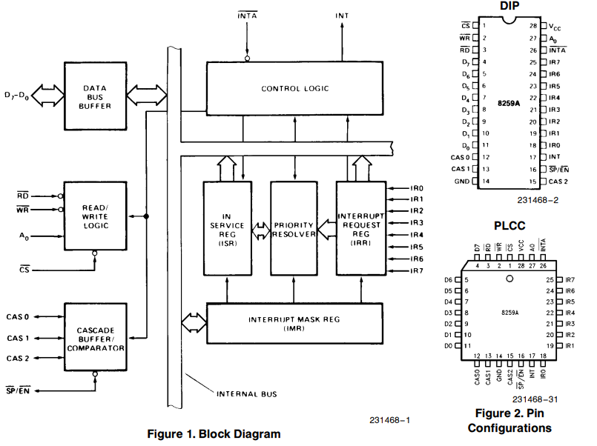
Programmable controllers
Programmable Interrupt Controller: 8259A
28-pin IC
Eight-level priority controller
Expandable to 64 levels
Programmable interrupt modes
Individual request mask capability
Notes:
No need to discuss too much about these modes. Move on…

Slide 13
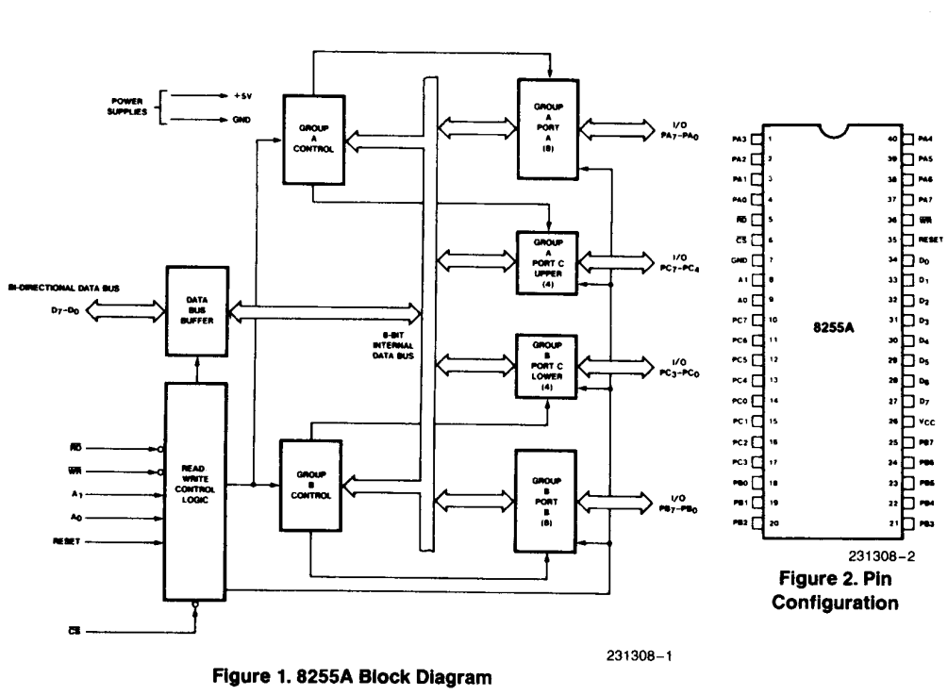
8255: Programmable peripheral interface
40-pin chip
Provides three 8-bit ports (24 lines) – A, B, C
Ports A and B may be used at 8-bit input or output ports
Port C may be used a single 8-bit I/O or two 4-bit I/O ports or produce handshake signals for A and B.
Group A – Port A and upper nibble of Port C
Group B – Port B and lower nibble of Port C
Interfaces directly with 808x for RESET logic. All lines are input on reset.
2-bit address lines (demuxed)
0 (A), 1 (B), 2 (C), 3 (Control)
8-bit control code for setting operating modes and bits.
Modes – Simple I/O, Strobed I/O, Strobed Bi-Di I/O.
Notes:
No need to discuss too much about these modes. Move on…

Slide 14
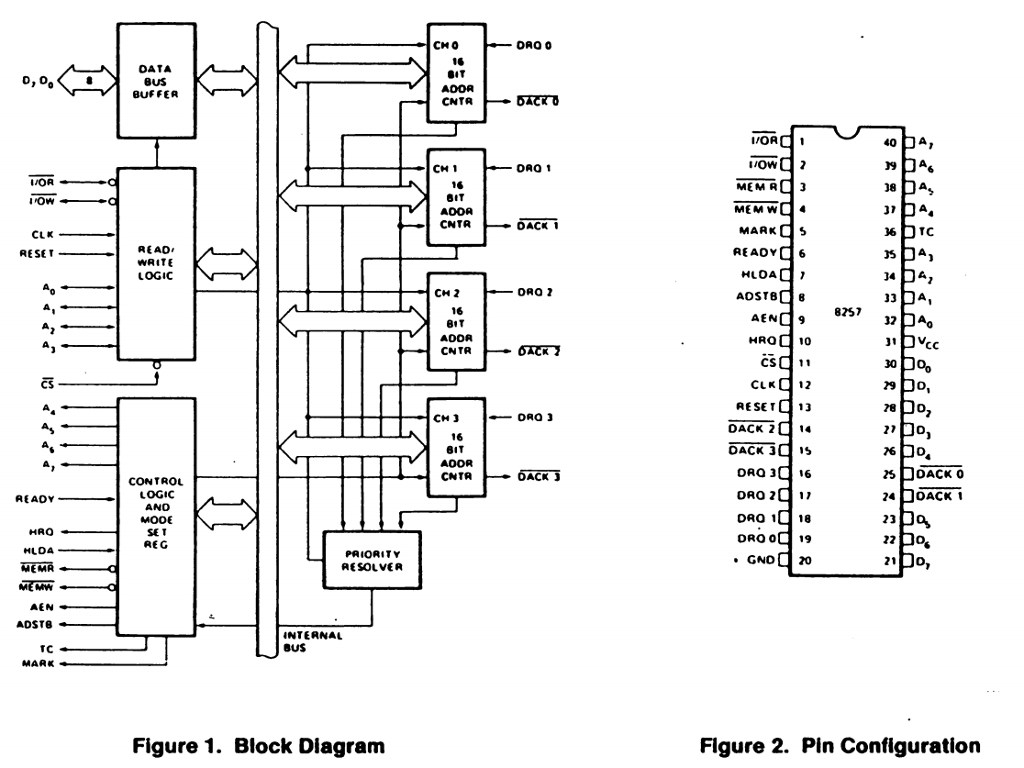
Programmable controllers
Programmable DMA Controller: 8257A
4-channel DMA controller
Priority DMA request logic
Terminal count and Modulo 128 outputs
Auto load mode
Notes:
No need to discuss too much about these modes. Move on…

Slide 15
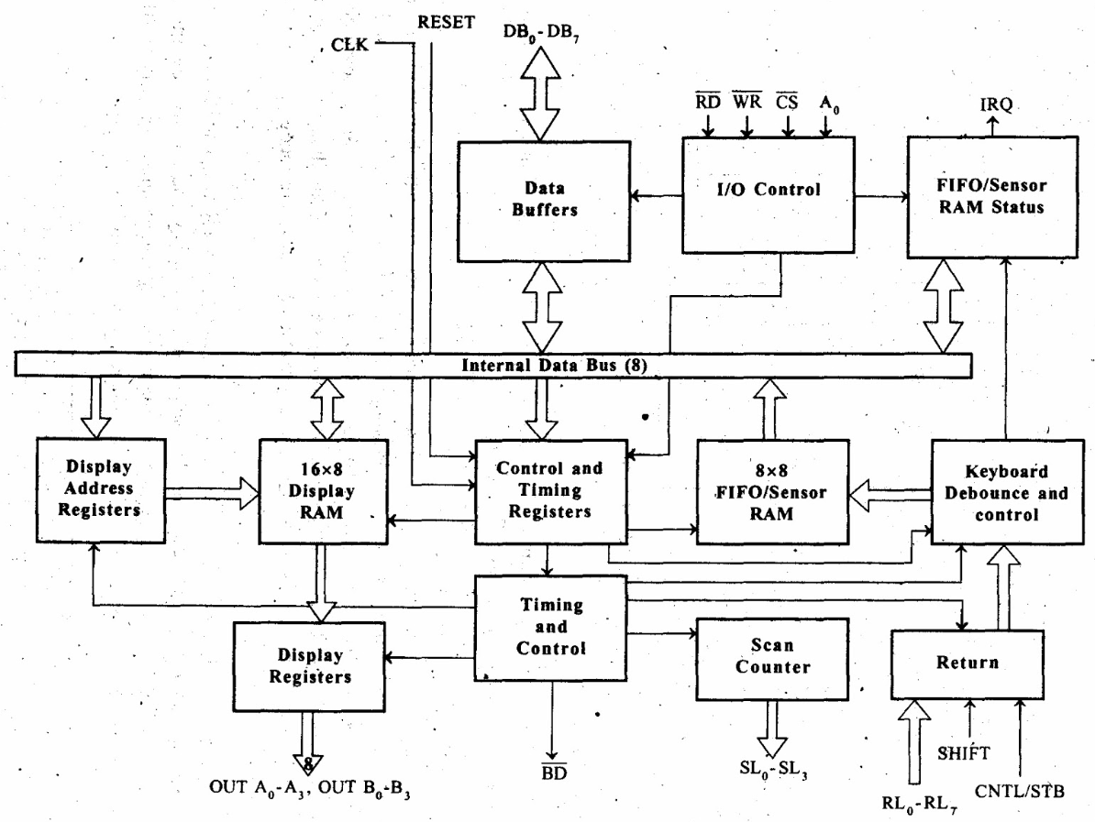
Programmable controllers
Programmable keyboard/Display controller: 8279
40-pin chip to interface keyboard and 7-segment LED display
Keyboard
Scans 8x8 key matrix, plus shift and control bits.
Debouncing, 2-key lockout, N-key rollover, auto-repeat
8-byte FIFO queue
Display
2x4-lines or 1x8 lines
16-byte buffer random-access.
Scan logic
Scans keyboard matrix and LED matrix – 4 lines
Encoded (2-bits) or decoded (4-bits) are supported.
Interface – 8-bit data, 8-bit control registers, 8 commands
Interrupt request line to processor.

